Slide 1
L‘archive à long terme de la Bibliothèque universitaire de Bâle
Stratégie et vision
Jürgen Enge juergen.enge@unibas.ch

Slide 2
TRUST Principles
Principle | Guidance for repositories
Transparency | To be transparent about specific repository services and data holdings that are verifiable by publicly accessible evidence.
Responsibility | To be responsible for ensuring the authenticity and integrity of data holdings and for the reliability and persistence of its service.
User Focus | To ensure that the data management norms and expectations of target user communities are met.
Sustainability | To sustain services and preserve data holdings for the long-term.
Technology | To provide infrastructure and capabilities to support secure, persistent, and reliable services.
Lin, D., Crabtree, J., Dillo, I. et al. The TRUST Principles for digital repositories. Sci Data 7, 144 (2020). https://doi.org/10.1038/s41597-020-0486-7

Slide 3
Interprétation au niveau de la technologie
Transparence : l’ensemble des processus sont faciles à comprendre et à communiquer
Responsabilité : celle-ci n'est possible que s'il y a une compréhension complète de l’organisation des contenus
Centré sur l'utilisateur : le système ne doit en faire ni trop ni trop peu
Durabilité : la durabilité repose sur des structures de données et de métadonnées bien définies dans les archives
Technologie : l’évolution technologique ne doit pas affecter les points ci-dessus

Slide 4
Caractéristiques
ndépendance
Durabilité
Lieu de stockage
Structure AIP
Système de gestion d'archives
Stockage

Slide 5
Conséquences
Indépendance
Durabilité
Cloud (public/private)
Stockage S3 /…
OCFL
Microservices
Distribution automatisée

Slide 6
OCFL
Oxford Common File Layout
This Oxford Common File Layout (OCFL) specification describes an application-independent approach to the storage of digital information in a structured, transparent, and predictable manner. It is designed to promote long-term object management best practices within digital repositories.
Specifically, the benefits of the OCFL include:
Completeness, so that a repository can be rebuilt from the files it stores
Parsability, both by humans and machines, to ensure content can be understood in the absence of original software
Robustness against errors, corruption, and migration between storage technologies
Versioning, so repositories can make changes to objects allowing their history to persist
Storage diversity, to ensure content can be stored on diverse storage infrastructures including conventional filesystems and cloud object stores
https://ocfl.io/1.1/spec/

Slide 7
OCFL
Nouvelles possibilités de migration de formats
Oxford Common File Layout
This Oxford Common File Layout (OCFL) specification describes an application-independent approach to the storage of digital information in a structured, transparent, and predictable manner. It is designed to promote long-term object management best practices within digital repositories.
Specifically, the benefits of the OCFL include:
Completeness, so that a repository can be rebuilt from the files it stores
Parsability, both by humans and machines, to ensure content can be understood in the absence of original software
Robustness against errors, corruption, and migration between storage technologies
Versioning, so repositories can make changes to objects allowing their history to persist
Storage diversity, to ensure content can be stored on diverse storage infrastructures including conventional filesystems and cloud object stores
https://ocfl.io/1.1/spec/

Slide 8
OCFL
Stockage équivalents dans plusieurs lieux
Oxford Common File Layout
This Oxford Common File Layout (OCFL) specification describes an application-independent approach to the storage of digital information in a structured, transparent, and predictable manner. It is designed to promote long-term object management best practices within digital repositories.
Specifically, the benefits of the OCFL include:
Completeness, so that a repository can be rebuilt from the files it stores
Parsability, both by humans and machines, to ensure content can be understood in the absence of original software
Robustness against errors, corruption, and migration between storage technologies
Versioning, so repositories can make changes to objects allowing their history to persist
Storage diversity, to ensure content can be stored on diverse storage infrastructures including conventional filesystems and cloud object stores
https://ocfl.io/1.1/spec/

Slide 9
OCFL
Source of Truth
Construction du système à partir des archives
Oxford Common File Layout
This Oxford Common File Layout (OCFL) specification describes an application-independent approach to the storage of digital information in a structured, transparent, and predictable manner. It is designed to promote long-term object management best practices within digital repositories.
Specifically, the benefits of the OCFL include:
Completeness, so that a repository can be rebuilt from the files it stores
Parsability, both by humans and machines, to ensure content can be understood in the absence of original software
Robustness against errors, corruption, and migration between storage technologies
Versioning, so repositories can make changes to objects allowing their history to persist
Storage diversity, to ensure content can be stored on diverse storage infrastructures including conventional filesystems and cloud object stores
https://ocfl.io/1.1/spec/

Slide 10
OCFL
Source of Truth
Construction du système à partir des archives
sécurité de la révision
métadonnées
médias

Slide 11
OCFL
Sécurité de la révision
gocfl
détection du format
migration
mise en paquets
validation
métadonnées
médias

Slide 12
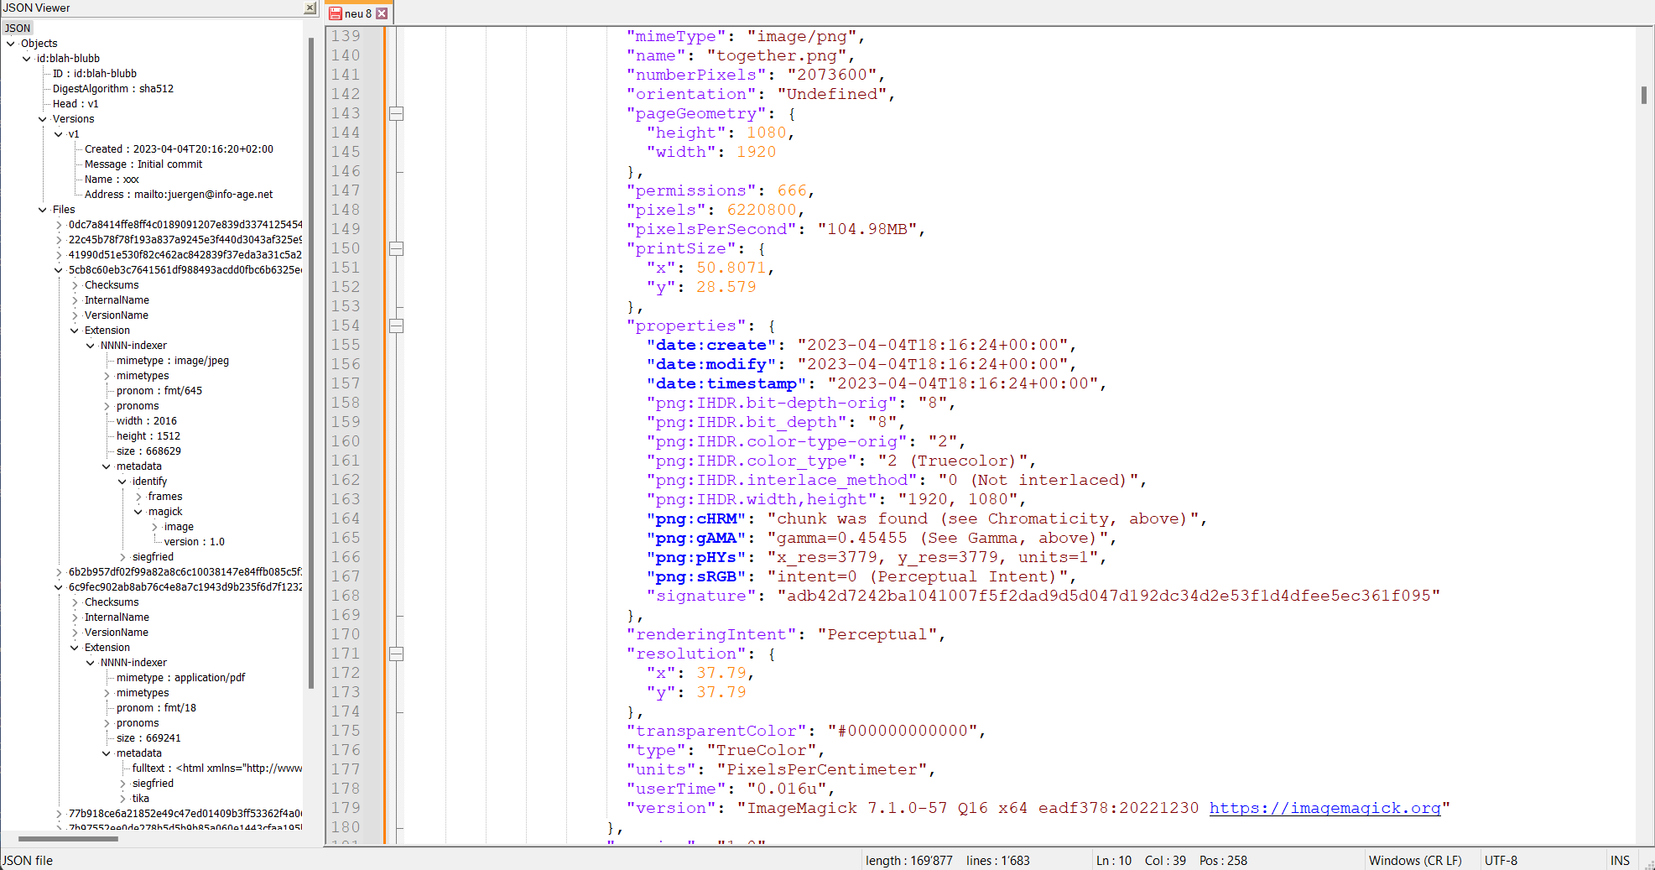
gocfl - métadonnées techniques
Revisionssicherheit
gocfl
Formaterkennung
Migration
Paketierung
Validierung
Metadaten
Metadaten
Medien
Medien

Slide 13
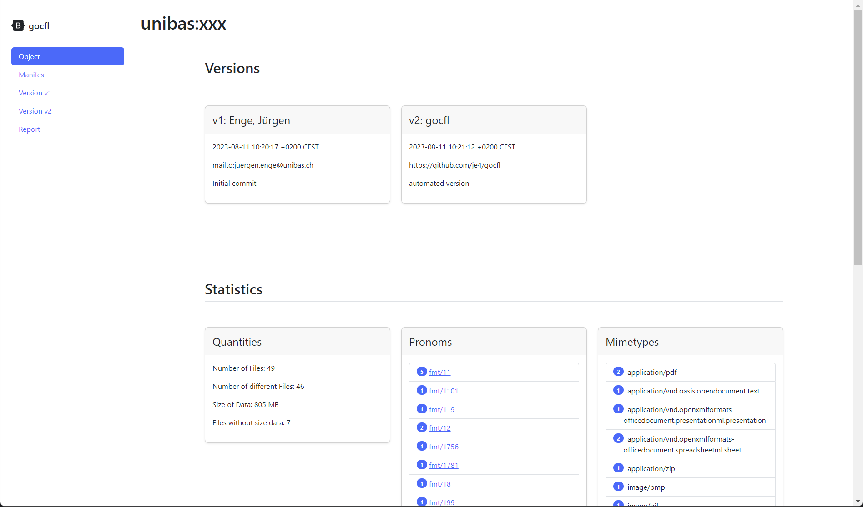
gocfl – reporting (browser)

Slide 14
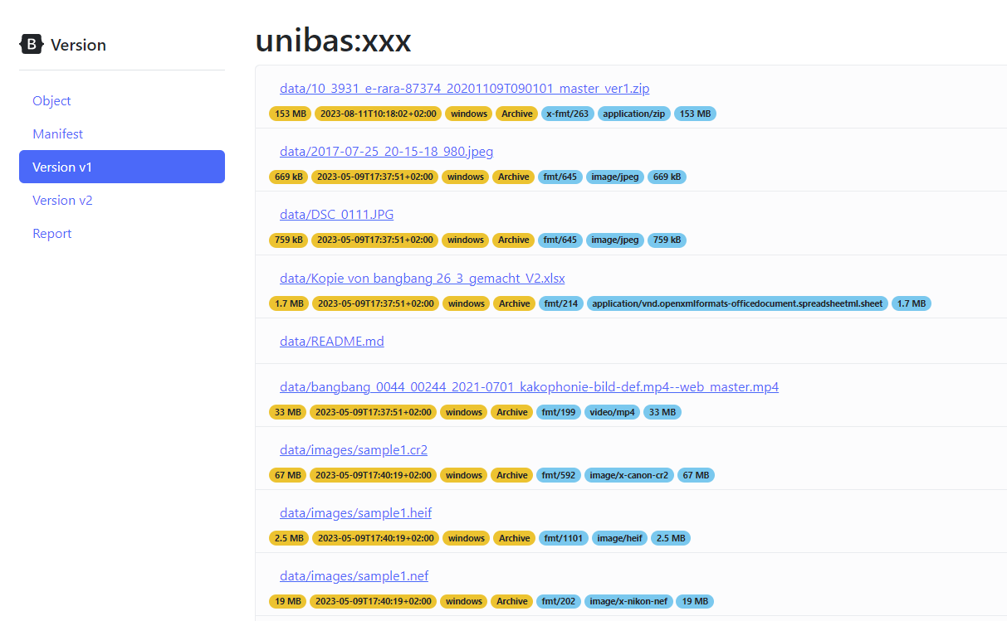
gocfl – reporting (browser)

Slide 15
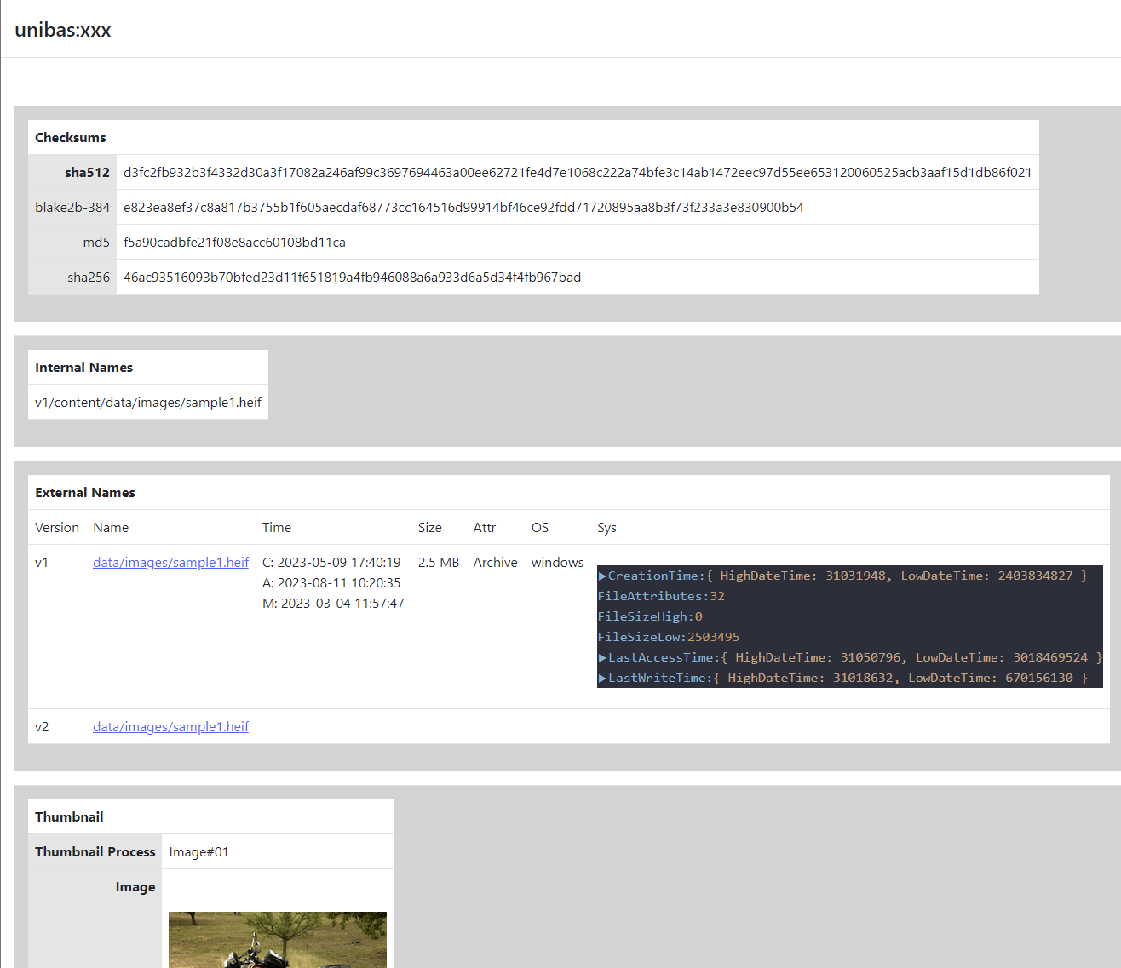
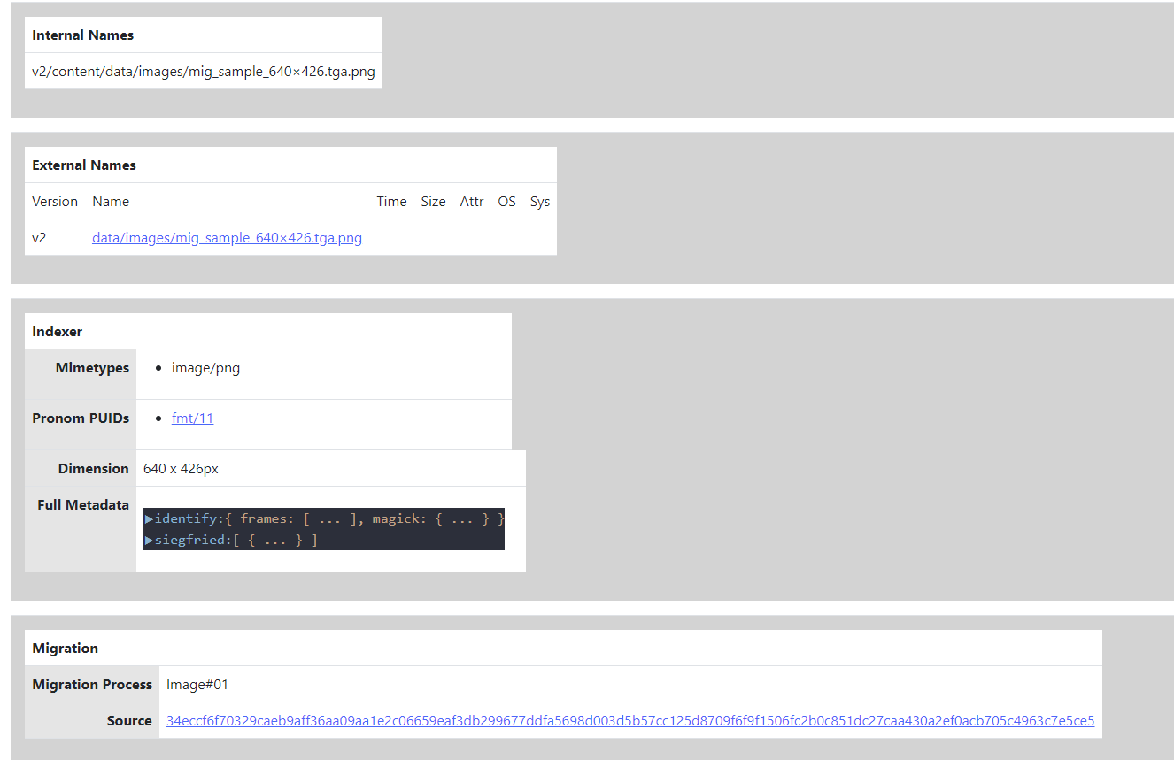
gocfl – reporting (browser)

Slide 16
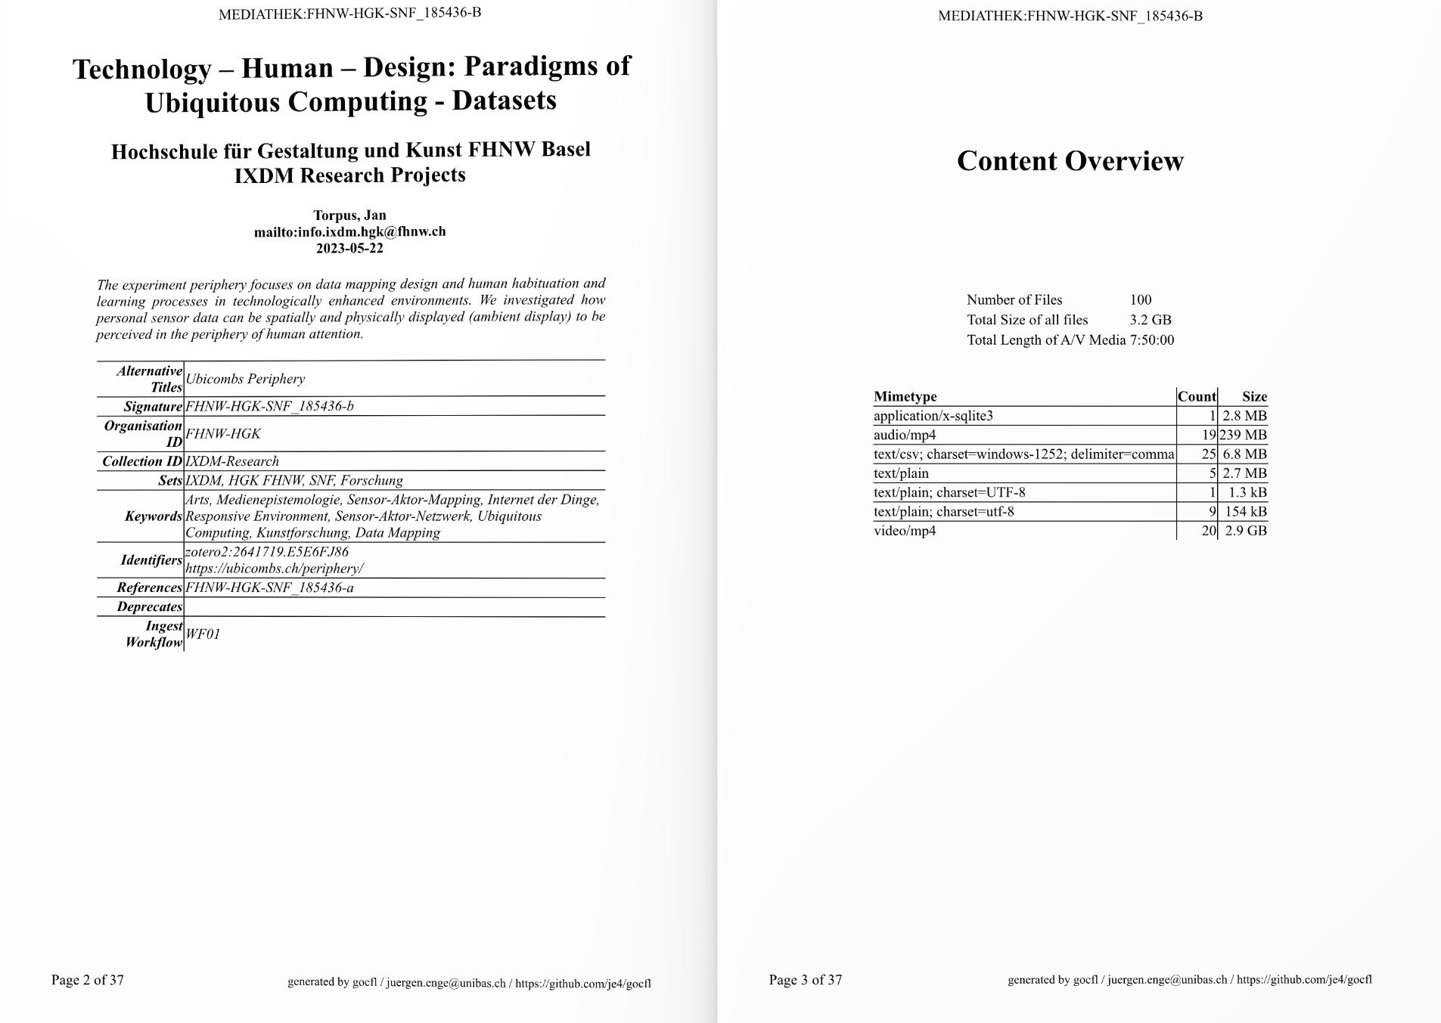
gocfl – reporting (PDF)
https://doi.org/10.26254/med/6352

Slide 17
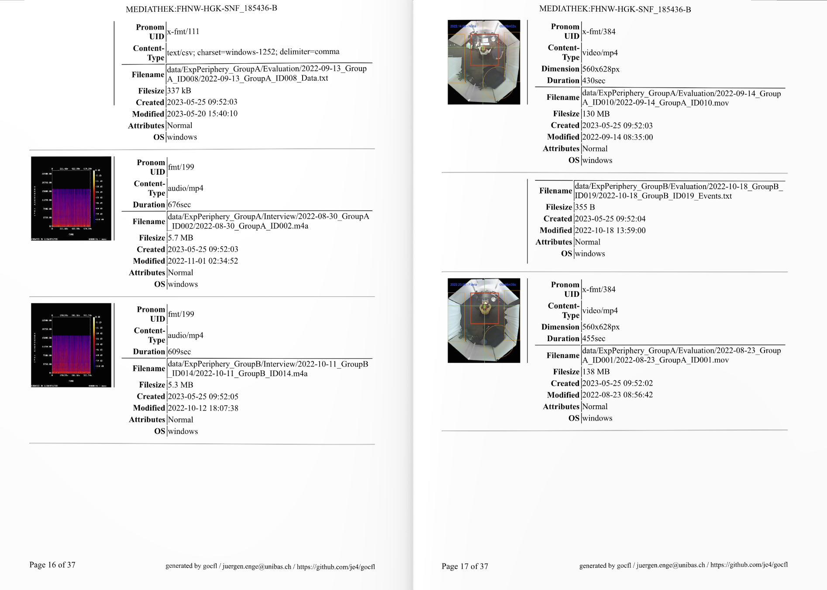
gocfl – reporting (PDF)
https://doi.org/10.26254/med/6352

Slide 18
Système d‘archivage à long terme UB
Archival Storage System
Reporter
Mapper
Unibas sciCore (S3)
Unibas sciCore (S3)
Digispace
Ingester
SIP Builder
gocfl
détection de format
migration
Mediaserver
SWITCHcoldstor (S3)
mise en paquet
SWITCHcoldstor Lausanne (S3)
validation
Archival Manager
Indexer
Checker
UB Disk Storage
SWITCHcoldstor Zürich (S3)
Dispatcher
Medien

Slide 19
Système d‘archivage à long terme UB
Archival Storage System
Séparation du stockage et de la gestion:
Prestataire de stockage indépendant du système de gestion des archives
Gestion des archives en tant qu'architecture de microservices
Multitenant
Idée:
Exploitation centralisée de la gestion des archives
Stockage décentralisé basé sur la qualité et les coûts souhaités
Reporter
Unibas sciCore (S3)
Unibas sciCore (S3)
Ingester
gocfl
détection de formats
migration
SWITCHcoldstor (S3)
Paquetage
SWITCHcoldstor Lausanne (S3)
validation
Archival Manager
Checker
UB Disk Storage
SWITCHcoldstor Zürich (S3)
Dispatcher
Medien

Slide 20
Merci pour votre attention
Jürgen Enge juergen.enge@unibas.ch

